Slide 1

Building RAG with LlamaIndex (+Data Tips/Tricks!)
Jerry Liu, LlamaIndex co-founder/CEO

Slide 2
RAG

Slide 3

Context
LLMs are a phenomenal piece of technology for knowledge generation and reasoning. They are pre-trained on large amounts of publicly available data.
Use Cases
Question-Answering
Text Generation
Summarization
Planning
LLM’s

Slide 4
















Context
How do we best augment LLMs with our own private data?
Raw Files
API’s
?
Use Cases
Question-Answering
Text Generation
Summarization
Planning
Vector Stores
SQL DB’s
LLM’s

Slide 5
LlamaIndex: A data framework for LLM applications
Data Management and Query Engine for your LLM application
Offers components across the data lifecycle: ingest, index, and query over data
Data Ingestion (LlamaHub 🦙)
Data Structures
Retrieval and Query Interface
Connect your existing data sources and data formats (API’s, PDF’s, docs, SQL, etc.)
Store and index your data for different use cases. Integrate with different db’s.
Given an input prompt, retrieve relevant context and synthesize a knowledge-augmented output.

Slide 6
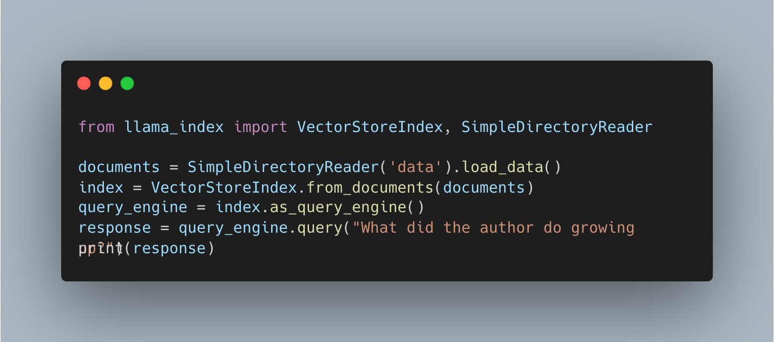

Slide 7
LLM App Use Cases
Passive
Interactive
Summarization
Translation
Schema extraction
Q&A over document(s)
Generative search (retrieval augmented generation)
Simple
reasoning
Headless agent
Conservational agent
Structured analytics
Complex/multistep reasoning

Slide 8
LLM App Use Cases
Passive
Interactive
Summarization
Translation
Schema extraction
Q&A over document(s)
Generative search (retrieval augmented generation)
Simple
reasoning
Challenge: Data Management & Orchestration
Headless agent
Conservational agent
Structured analytics
Complex/multistep reasoning

Slide 9
Naive RAG Stack for building a QA System
Data Ingestion / Parsing
Data Querying
Chunk
Vector Database
Chunk
Doc
Chunk
Chunk
LLM
Chunk
Chunk
Chunk

Slide 10
Current RAG Stack (Data Ingestion/Parsing)
Naive State:
Split up document(s) into even chunks.
Each chunk does not contain parent context.
All chunks are stored in the same collection in a vector database.
Chunk
Vector Database
Chunk
Doc
Chunk
Chunk

Slide 11
Current RAG Stack (Querying)
Naive State:
Find top-k most similar chunks from vector database collection
Plug into LLM response synthesis module
Vector Database
Chunk
LLM
Chunk
Chunk

Slide 12
Challenges with Naive RAG (Response Quality)
When RAG fails, the most common reason is bad retrieval
If the retrieved results are bad, there’s no way the LLM can synthesize a proper response without hallucinating!
The most common retrieval method is top-k embedding lookup

Slide 13
Challenges with Naive RAG (Response Quality)
Causes of bad retrieval quality
Each chunk does not have awareness of parent context or related context
The query assumes a certain traversal structure that top-k embedding lookup doesn’t utilize.
The data is redundant or out of date

Slide 14
Challenges with Naive RAG (System Concerns)
There are also system-level considerations with this stack
How do you deal with updates in the source document?
How do you update stored chunks in the vector database?

Slide 15
Key Lessons
To improve your RAG stack,
Improve the way you define state, not just the retrieval algorithm!

Slide 16
Data Tips/Tricks for Better Performing RAG

Slide 17
Augmenting Chunks with Context
One of the reasons embedding retrieval fails is that relevant context chunks do not match the query embedding
Different Context Augmentation Strategies
Injecting Metadata
Defining Node Relationships
Summary
{“page_num”: 1, “org”: “OpenAI”}
Metadata
We report the development of GPT-4, a large-scale, multimodal…
Text Chunk
parent
prev
next
Chunk
Chunk
Chunk

Slide 18
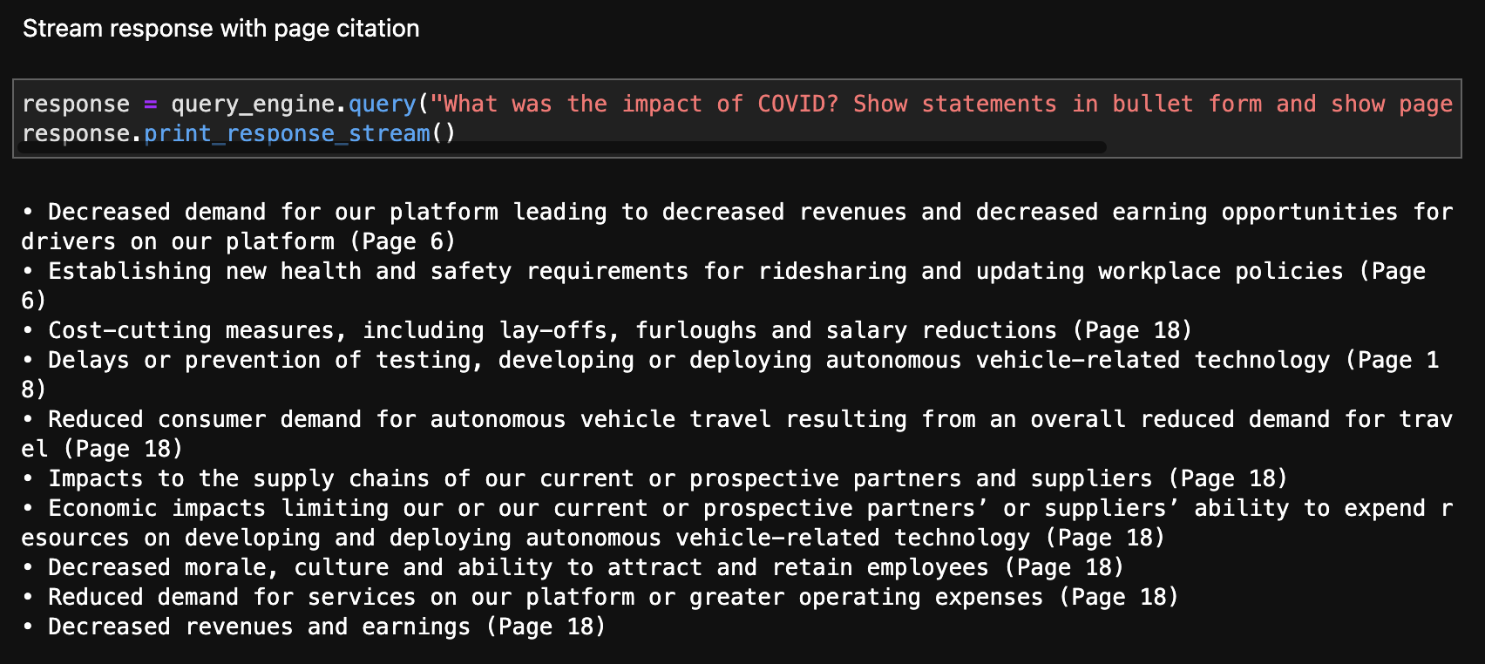
Simple use case: adding page numbers to PDF’s allows for in-line citations

Slide 19
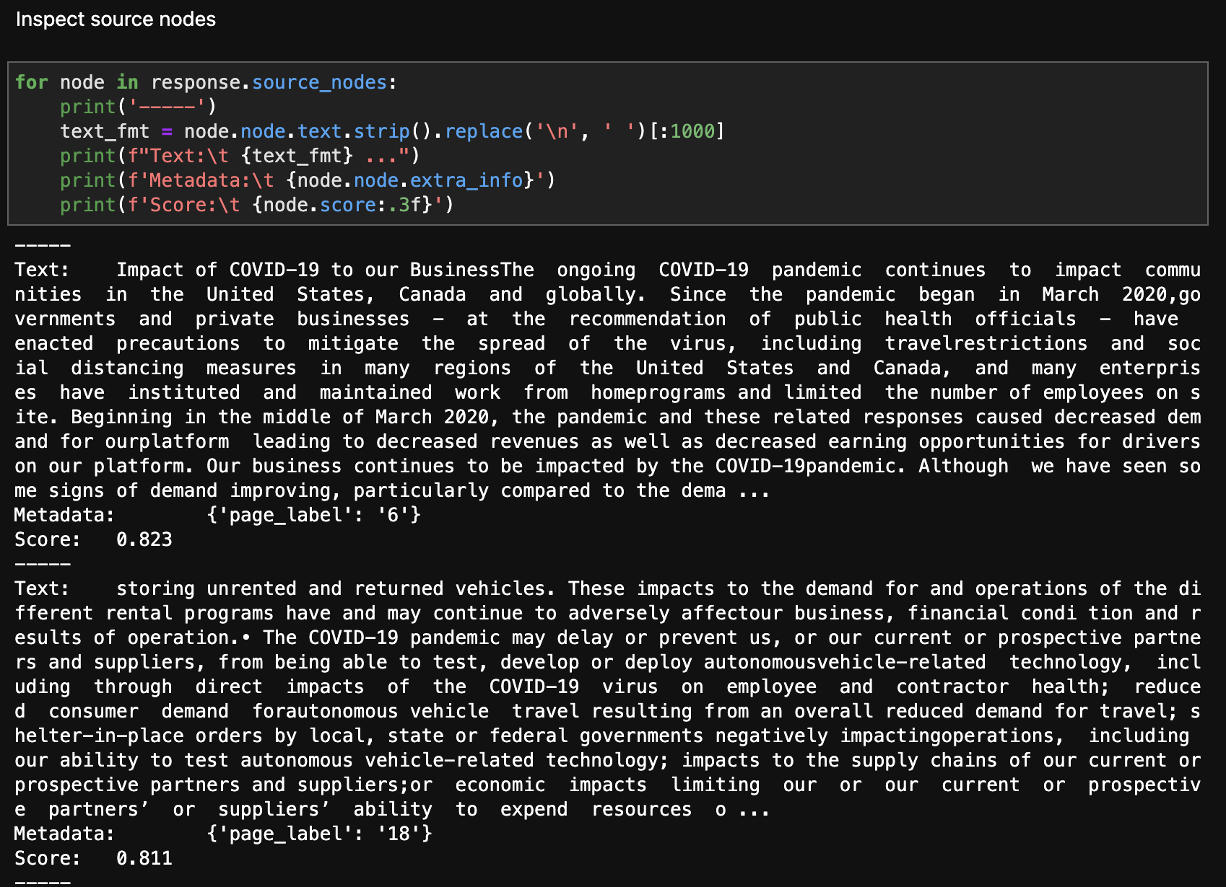
Simple use case: adding page numbers to PDF’s allows for in-line citations

Slide 20
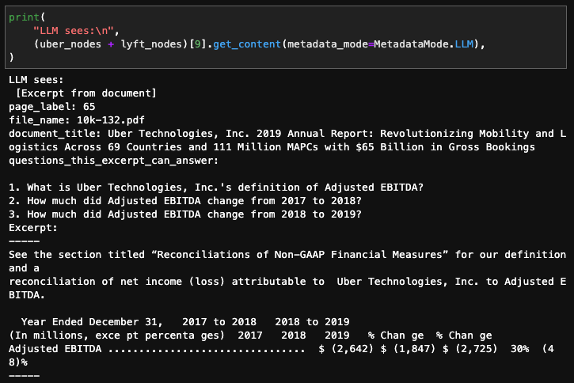
Using LLMs for Automatic Metadata Extraction

Slide 21
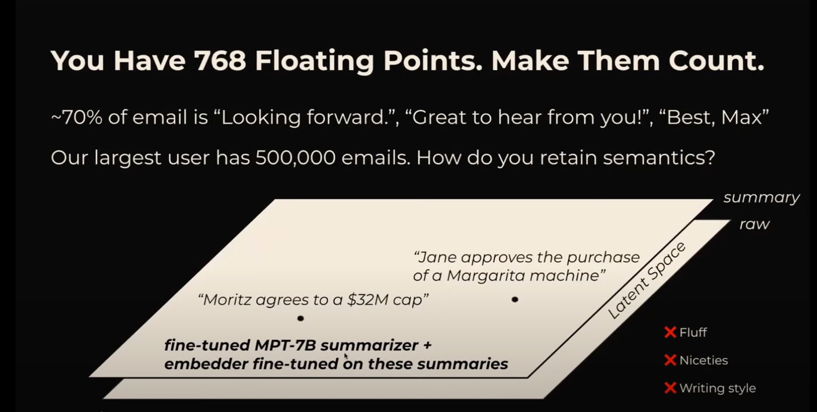
Decouple Embeddings from Raw Text Chunks
Raw text chunks can bias your embedding representation with filler content (Max Rumpf, sid.ai)

Slide 22
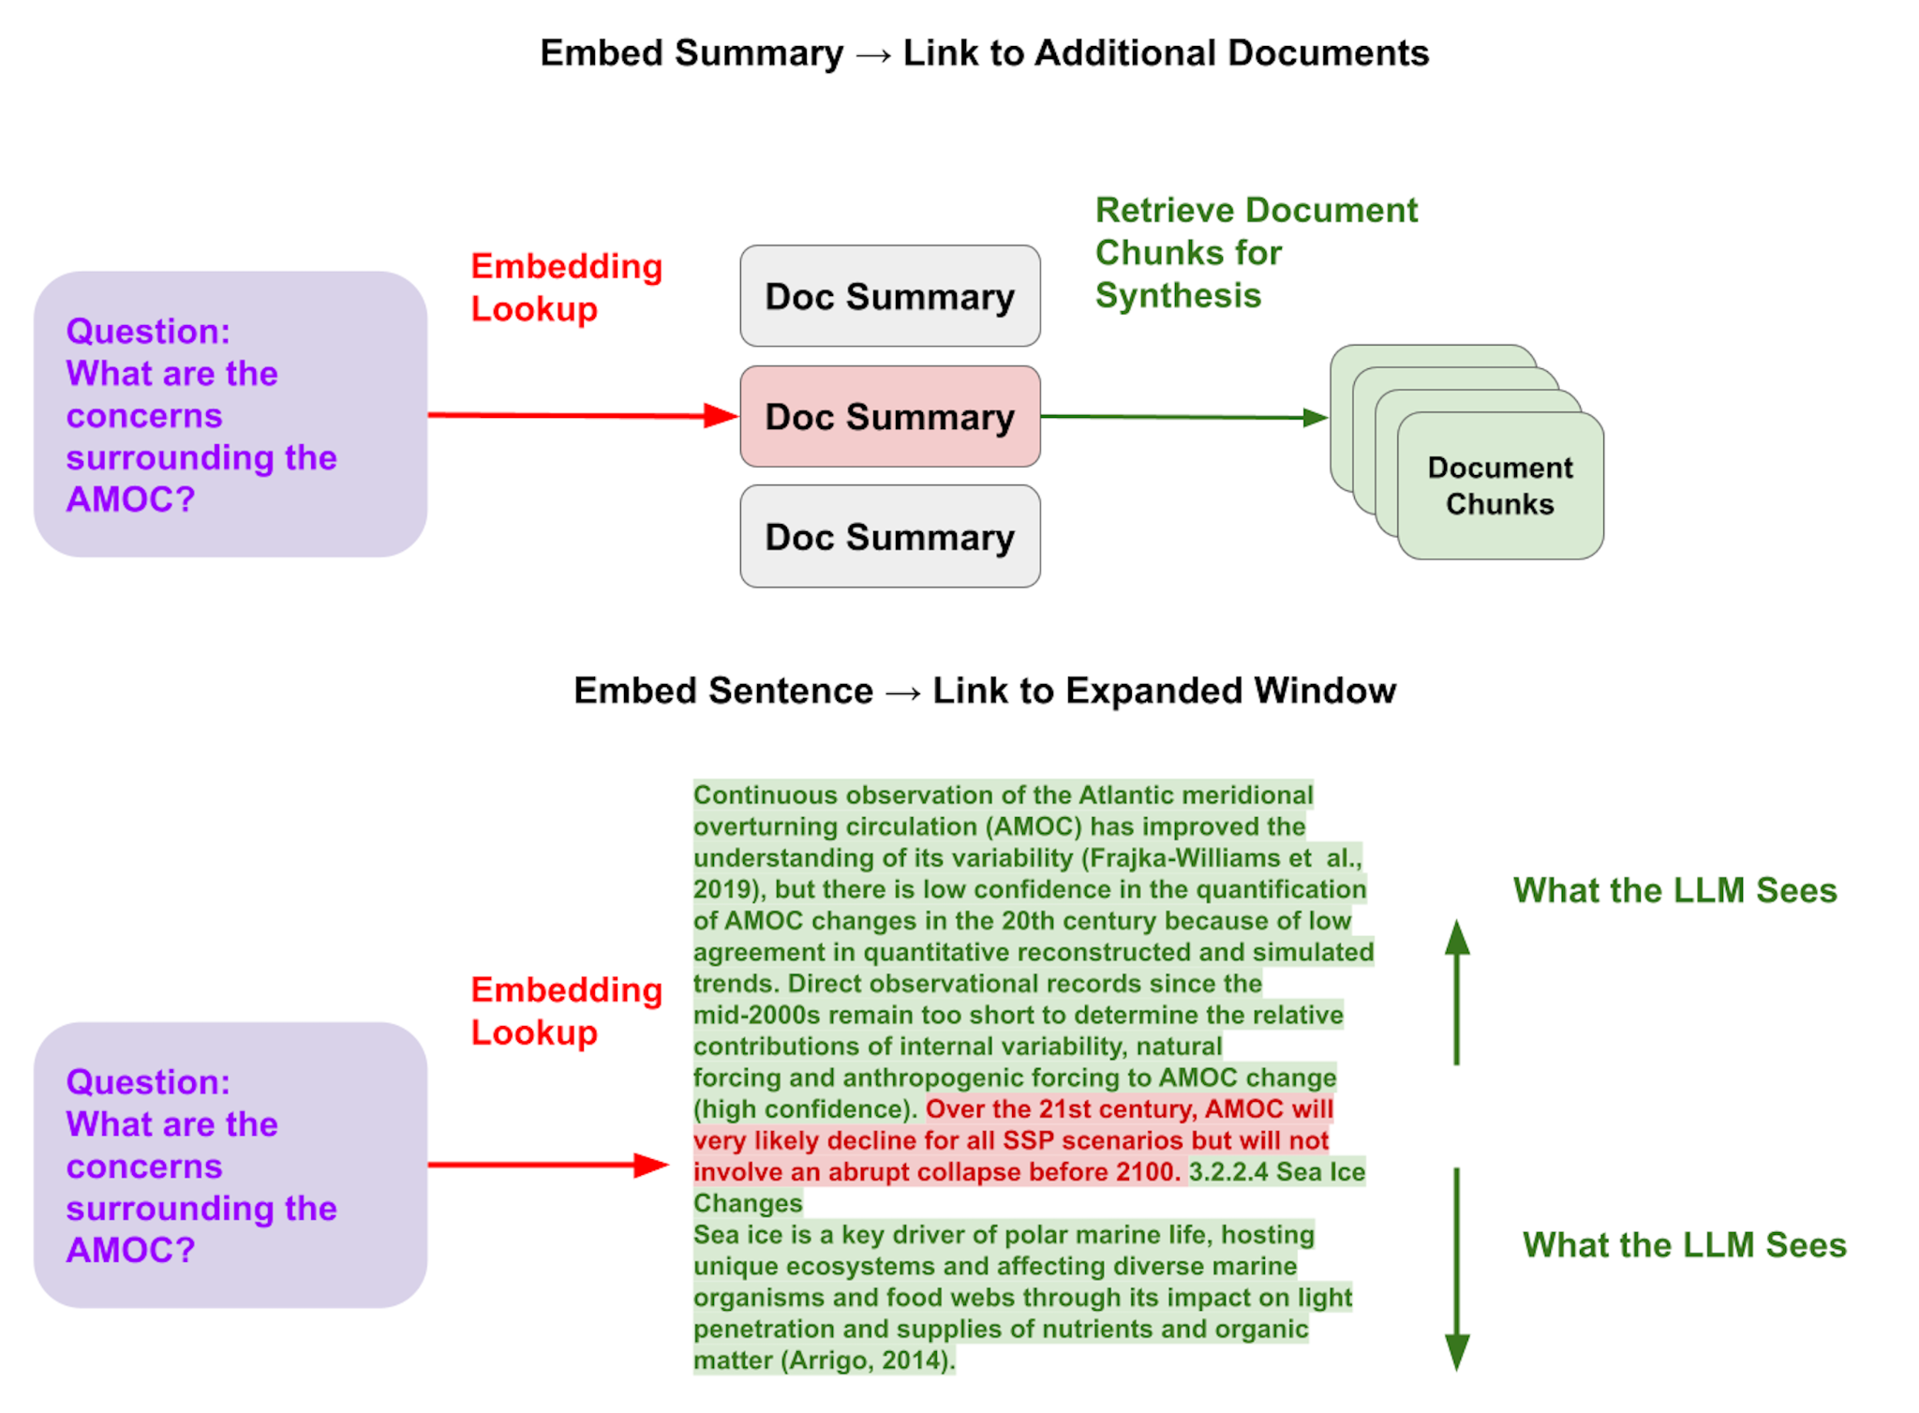
Decouple Embeddings from Raw Text Chunks
Solutions:
Embed larger documents via summaries
Embed text at the sentence-level - then expand that window during LLM synthesis
Finetune embeddings over a specific corpus

Slide 23
Organize your data for more structured retrieval
Question: “Can you tell me about Google’s R&D initiatives from 2020 to 2023?”
Dumping chunks to a single collection doesn’t work.
2020 10Q chunk 4
top-4
2020 10Q chunk 7
query_str: <query_embedding>
Single Collection of all 10Q Document Chunks
2021 10Q chunk 4
2023 10Q chunk 4
No guarantee you’ll return the relevant document chunks!

Slide 24
Organize your data for more structured retrieval
Question: “Can you tell me about Google’s R&D initiatives from 2020 to 2023?”
Here, we separate and tag the documents with metadata filters.
During query-time, we can infer these metadata filters in addition to semantic query.
query_str: <query_embedding>
Metadata tags:
<metadata_tags>
2020 10Q
2020 10Q chunk 4
2021 10Q
2021 10Q chunk 4
2022 10Q
2022 10Q chunk 4
2023 10Q
2023 10Q chunk 4

Slide 25
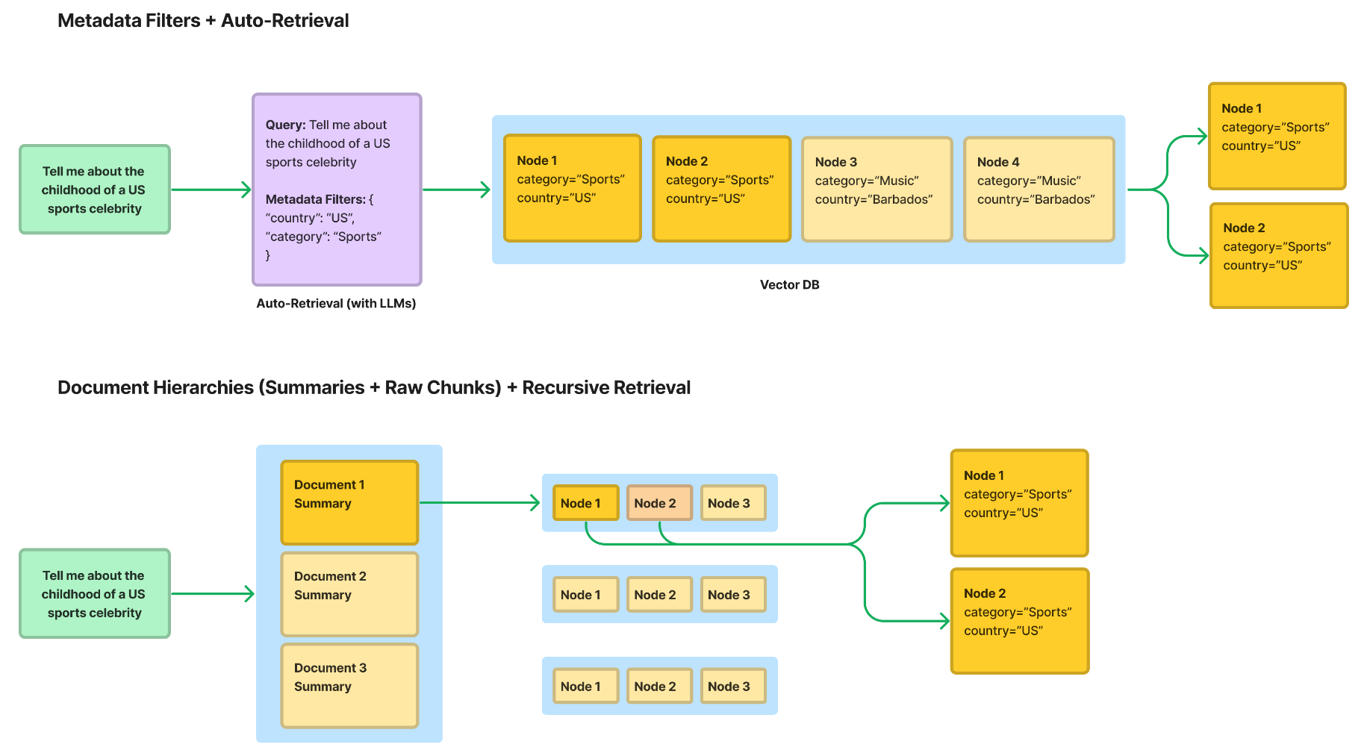
Organize your data for more structured retrieval
Two main approaches here

Slide 26
Data Solutions in LlamaIndex
Define/customize metadata: https://gpt-index.readthedocs.io/en/latest/how_to/customization/custom_documents.html
Automatic metadata extraction: https://gpt-index.readthedocs.io/en/latest/how_to/index/metadata_extraction.html
Document Comparisons: https://gpt-index.readthedocs.io/en/latest/examples/query_engine/sub_question_query_engine.html
Comparing document structuring approaches: https://gpt-index.readthedocs.io/en/latest/examples/retrievers/auto_vs_recursive_retriever.html
Sentence-level Retrieval + Expanded Context During LLM Synthesis:
https://gpt-index.readthedocs.io/en/latest/examples/node_postprocessor/MetadataReplacementDemo.html
Handling Document Updates: https://gpt-index.readthedocs.io/en/latest/how_to/index/usage_pattern.html#handling-document-update

